Slide 1


TutionHub
A Smart Solution for Tuition Center Management

Slide 2

Table of Contents
Project Overview
Admin Features
Teacher Features
Technical Implementation
UI/UX Design
Conclusion and Future Enhancements

Slide 3

Project Overview
Mobile app for tuition center management
Supports three roles: Admin, Teacher, Student
Features: Attendance, Results, Assignments, Payments
Reduces manual work and enhances communication

Slide 4
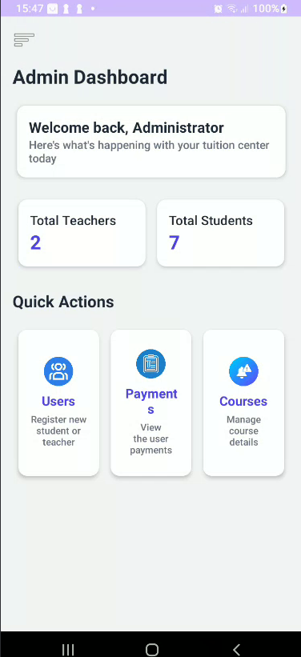
Admin Features
Register/manage students and teachers
Assign students to teachers and courses
Manage Payments

Slide 5
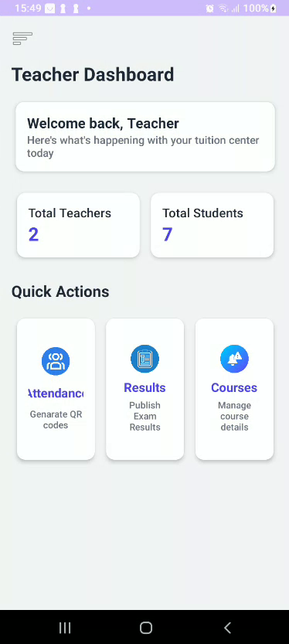
Teacher Features
Genarate QR code for each day per course
Upload assignments and publish results
Upload and manage course materials

Slide 6
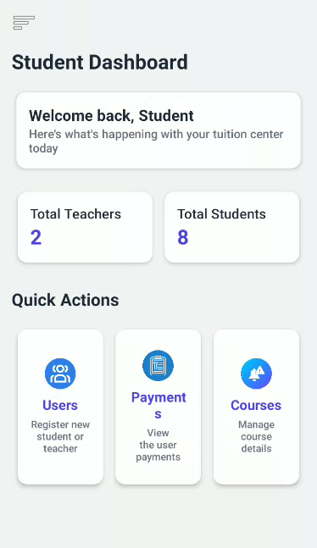
Student Features
Mark attendance, View assignments, and results
Submit assignments through the app
Access shared course materials
Upload payment slips

Slide 7

UI/UX Design
Clean, intuitive and Minimalistic interface
Role-based dashboards (Admin, Teacher, Student)
Responsive layouts for mobile devices
Screens: Login, Attendance, Materials, Assignments, payments…….

Slide 8

Conclusion and Future Enhancements
Functional tuition management app completed
Covers all core Android and module concepts
Future improvements:
Online payment gateway
Chat/messaging feature
Analytics dashboard
Report Genaration

Slide 9
Thank You
- A Project By Group 15 -

